Slide 1
Concept of Work Teams
Teams are getting popular in modern organizations. More and more organizations are restructuring themselves around teams to better utilize employee talents. Work group and work teams are not the same thing.
A work group is a group that interacts primarily to share information and make decisions to help each member perform. Its performance is summation of what its members perform as individuals. A work team is a cooperative group whose individual efforts result in positive synergy through coordinated effort

Slide 2
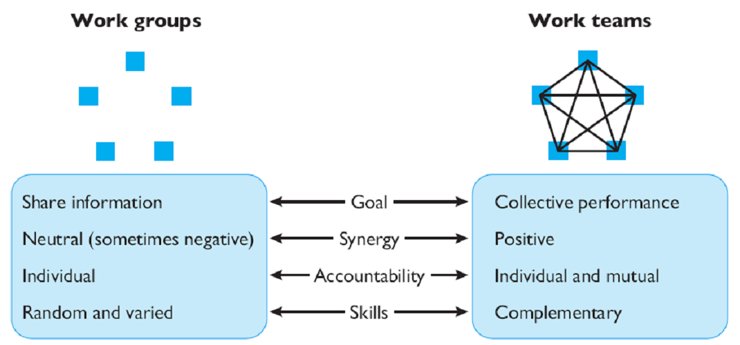

Slide 3
Team Building
Team building is a management technique used for improving the efficiency and performance of the workgroups through various activities. It involves a lot of skills, analysis and observation for forming a strong and capable team. The whole sole motive here is to achieve the organization vision and objectives.

Slide 4
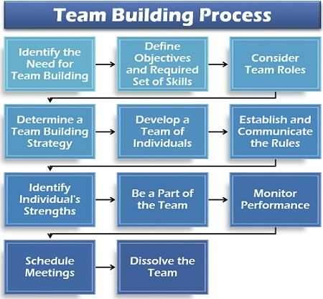
Team Building Process

Slide 5
Identify the Need for Team Building :The manager has first to analyze the requirement of a team for completing a particular task. It should find out the purpose of the work to be performed, required skills for the job and its complexity before forming a team.
Define Objectives and Required Set of Skills :Next comes the chalking down of the organizational objectives and the skills needed to fulfil it.
Consider Team Roles :The manager considers the various aspects, i.e. the interactions among the individuals, their roles and responsibilities, strengths and weaknesses, composition and suitability of the possible team members.

Slide 6
Determine a Team Building Strategy Now, the manager has to understand the operational framework well to ensure an effective team building. He must himself be assured of the objectives, roles, responsibilities, duration, availability of resources, training, the flow of information, feedback and building trust in the team.
Develop a Team of Individuals : At this stage, the individuals are collected to form a team together. Each member is made familiar with his roles and responsibilities within the team.
Establish and Communicate the Rules :The rules regarding the reporting of team members, meeting schedules, and decision making within the team are discussed. The individuals are encouraged to ask questions and give their views to develop open and healthy communication in the team.

Slide 7
Identify Individual’s Strengths :Various team-building exercises are conducted to bring out the strengths of the individuals. It also helps in familiarizing the team members with each other’s strengths and weakness.
Be a Part of the Team :At this point, the manager needs to get involved with the team as a member and not as a boss. Making the individuals realize their importance in the team and treating each member equally is necessary. The team members should see their manager as their team leader, mentor and role model.
Monitor Performance :Next step is checking the productivity and performance of the team as a whole. It involves finding out loopholes and the reasons for it. This step is necessary to improve the team’s performance and productivity in the long run.

Slide 8
Schedule Meetings :One of the most crucial steps is to hold purposeful meetings from time to time to discuss team performance, task-related problems and discuss the future course of action.
Dissolve the Team :Lastly, the manager needs to evaluate the results and reward the individuals on their contribution and achievement. Finally, the team is dispersed on the fulfilment of the objective for which it was formed.

Slide 9
Leadership
Leadership refers to the art of motivating people in an organization to work towards a common goal. It is based on ideas which can be a person’s own or inspired by other leaders. Leadership is also an art of communicating these ideas effectively to others and encouraging them to take up responsibilities and grow personally besides leading the company towards growth. Effective leadership is not only inspirational for the self but also for others. If you also want to become an inspirational and successful leader in the near future, it is important to understand that leaders must have certain critical thinking skills which can help them in directing an organization’s resources for better growth prospects.

Slide 10
Different Types of Leadership
1. Democratic Leadership :This is as clear as its name. In democratic leadership, the leaders make or break decisions democratically, based on their team’s opinion and feedback. Although it is the leader who makes the final call, every opinion counts. This is easily one of the most effective leadership styles since it allows employees to have a voice.
2. Autocratic Leadership :This is exactly the opposite of democratic leadership wherein the opinions of employees are not considered. Leaders with this style expect others to adhere to the decisions they take, which is not a sustainable approach in the long term.

Slide 11
3. Laissez-faire Leadership :Laissez-fire means “let them do”. This style is the least intrusive and leaders with this approach ensure that the authority lies with the employees. While this leadership style can empower, it may also limit development, therefore, must be kept in check.
4. Strategic Leadership :Strategic leadership acts as a bridge between the senior team and the employees. Leaders adopting this style ensure that both executive interests and working conditions for the team are stable when a decision is made

Slide 12
5. Transformational Leadership :This kind of leadership always aims at transforming and improving functions and capabilities. There may be tasks and schedules assigned and leaders following this style may ask employees to push their boundaries constantly. Most growth-minded companies tend to adopt this kind of a leadership style.
6. Transactional Leadership :This is a very common leadership style today based on the action-and-reward concept. For instance, an employee or team may receive an incentive or bonus for achieving a target set by the company.
7. Coach-Style Leadership :This leadership style focuses on larger growth while encouraging individual team members to focus on their strengths and talent. Though this is similar to strategic and democratic leadership styles, the focus here is more on the individual.

Slide 13
8. Bureaucratic Leadership : This kind of leadership style goes by the books. Although leaders with this approach do listen to employees and their opinions, they may negate or reject it, in case they go against the company’s ethos or policy.

Slide 14
Leadership Functions
1. Setting Goals: A leader is expected to perform creative function of laying out goals and policies to persuade the subordinates to work with zeal and confidence.
2. Organizing: The second function of a leader is to create and shape the organization on scientific lines by assigning roles appropriate to individual abilities with the view to make its various components to operate sensitively towards the achievement of enterprise goals.

Slide 15
3. Initiating Action: The next function of a leader is to take the initiative in all matters of interest to the group. He should not depend upon others for decision and judgment. He should float new ideas and his decisions should reflect original thinking.
4. Co-Ordination: A leader has to reconcile the interests of the individual members of the group with that of the organization. He has to ensure voluntary co-operation from the group in realizing the common objectives.

Slide 16
5. Direction and Motivation: It is the primary function of a leader to guide and direct his group and motivate people to do their best in the achievement of desired goals, he should build up confidence and zeal in the work group.
6. Link between Management and Workers: A leader works as a necessary link between the management and the workers. He interprets the policies and programmes of the management to his subordinates and represents the subordinates’ interests before the management. He can prove effective only when he can act as the true guardian of the interests of his subordinates.

